Slide 1
Intro to AI Mini-Project Presentation
Virginia Tech CS 4804 Fall 2022
Team: 11

Slide 2
Team:
Name: Tai-Jung Chen
Name: Bhargav Iyer
Name: Mayank Bhatia
Name: Parth Desai

Slide 3



Team Records
Race | 1 | 2 | 3
Track
Best Time | 2:36.380 | 2:51.655 | 02:21.657

Slide 4
Design Approaches
Track | Design Approaches
1 | Avoid being off track Increase speed if possible Speed up on straight line and slow down in corners Follow the center line
2 | Follow the center line Stay on track
3 | Stay on track (penalize heavily when off track) Promote straight-line speed (turning angle < 5) Stay within track bounds (center line not required)

Slide 5
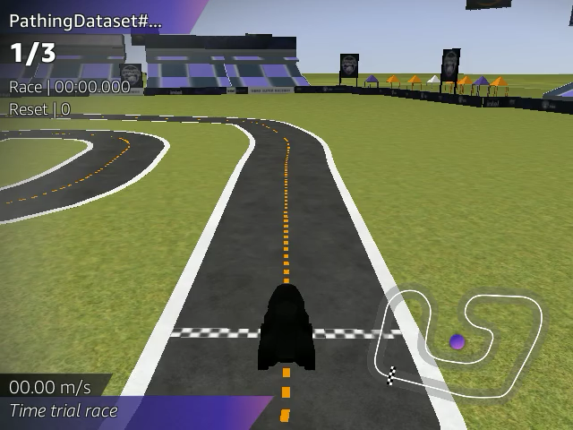
Demo
Notes:
Right click and click save video

Slide 6
Track 1: Lesson Learned
How to transform strategies into reward functions
How to incorporate the know-how of the domain knowledge into data driven models
How to observe and discover the advantages and disadvantages of the models
How to optimize limited resources while developing the models

Slide 7
Track 2: Lessons learned
Training time makes a difference.
How to use rewards
Testing using the same track can improve time.

Slide 8
Track 3: Lessons learned
Increased training time makes a difference
Speed shouldn’t be a penalty, rather an additional reward
algorithms with less strict requirements seem to require more training time
However it can produce a better result
Testing on a particular track can improve times but also reduce ecological validity.

Slide 9
Q & A
Thank you!

